Slide 1
Set Yourself up for Architect Success
Smart ways to use your career and skills
Gemma Emmett, Solution Architect & Salesforce MVP
@gemziebeth
gemma@archladies.com
Notes:
Before you can climb Mt. CTA and become a Certified Technical Architect, you have to get to the mountain itself. Not sure how? Take away some smart ways to use your career and skills and set yourself up for certification success.

Slide 2
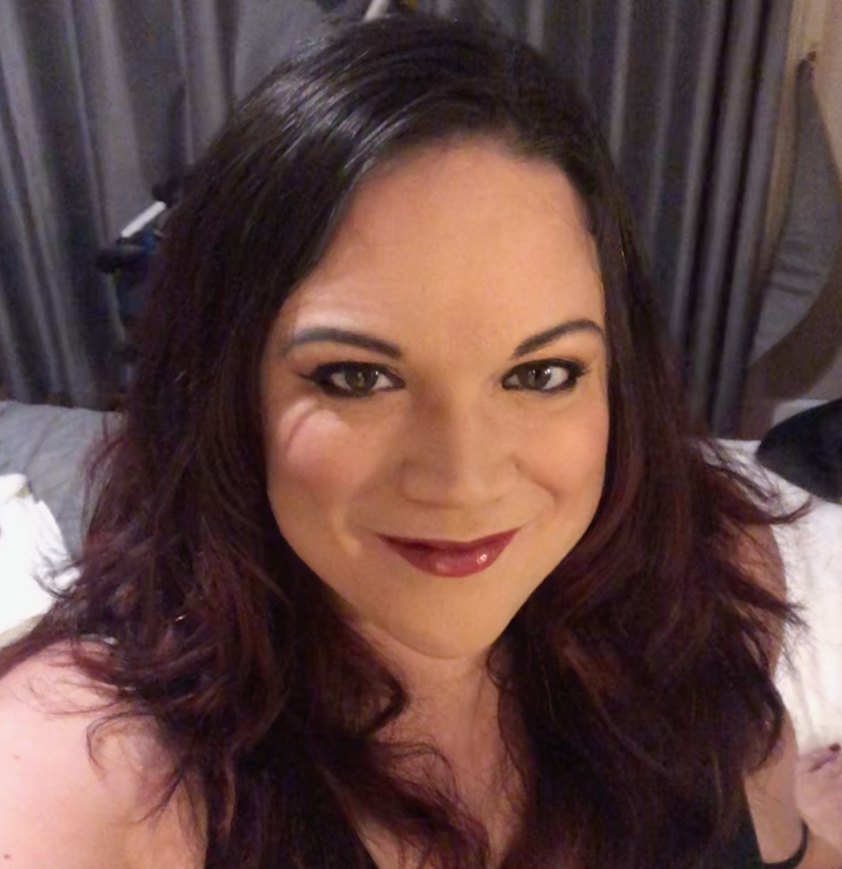
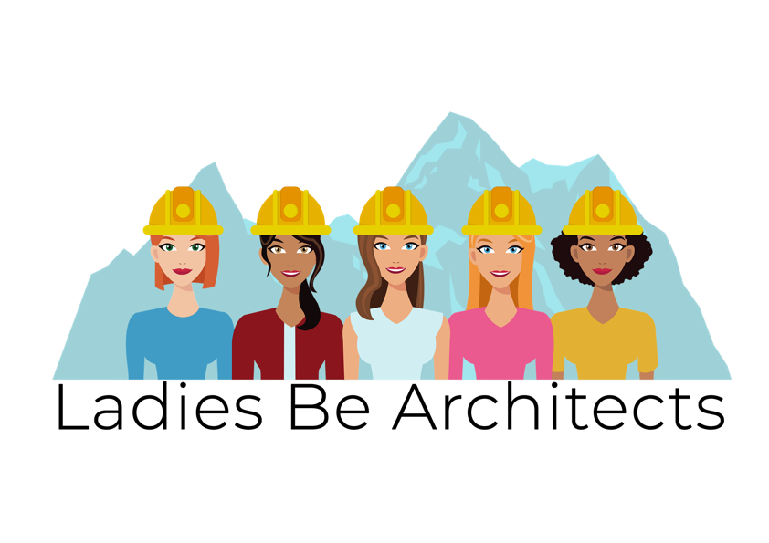
Gemma Emmett
Solution Architect
Founder of Ladies Be Architects
@gemziebeth
Nominee

Slide 3
An Architect is
Creative
Innovative
A Bigger Picture Thinker
Always Learning
A Designer
A Teacher
A Fixer
A Problem Solver

Slide 4
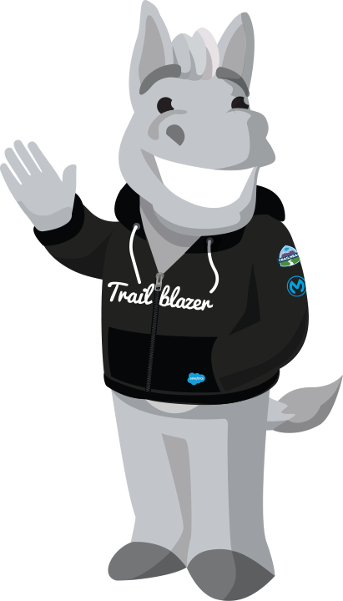
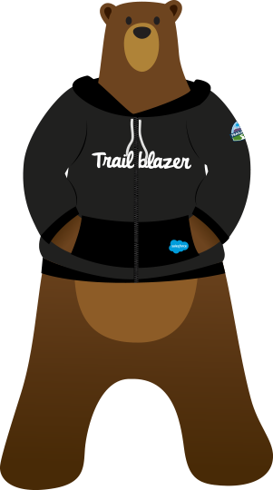
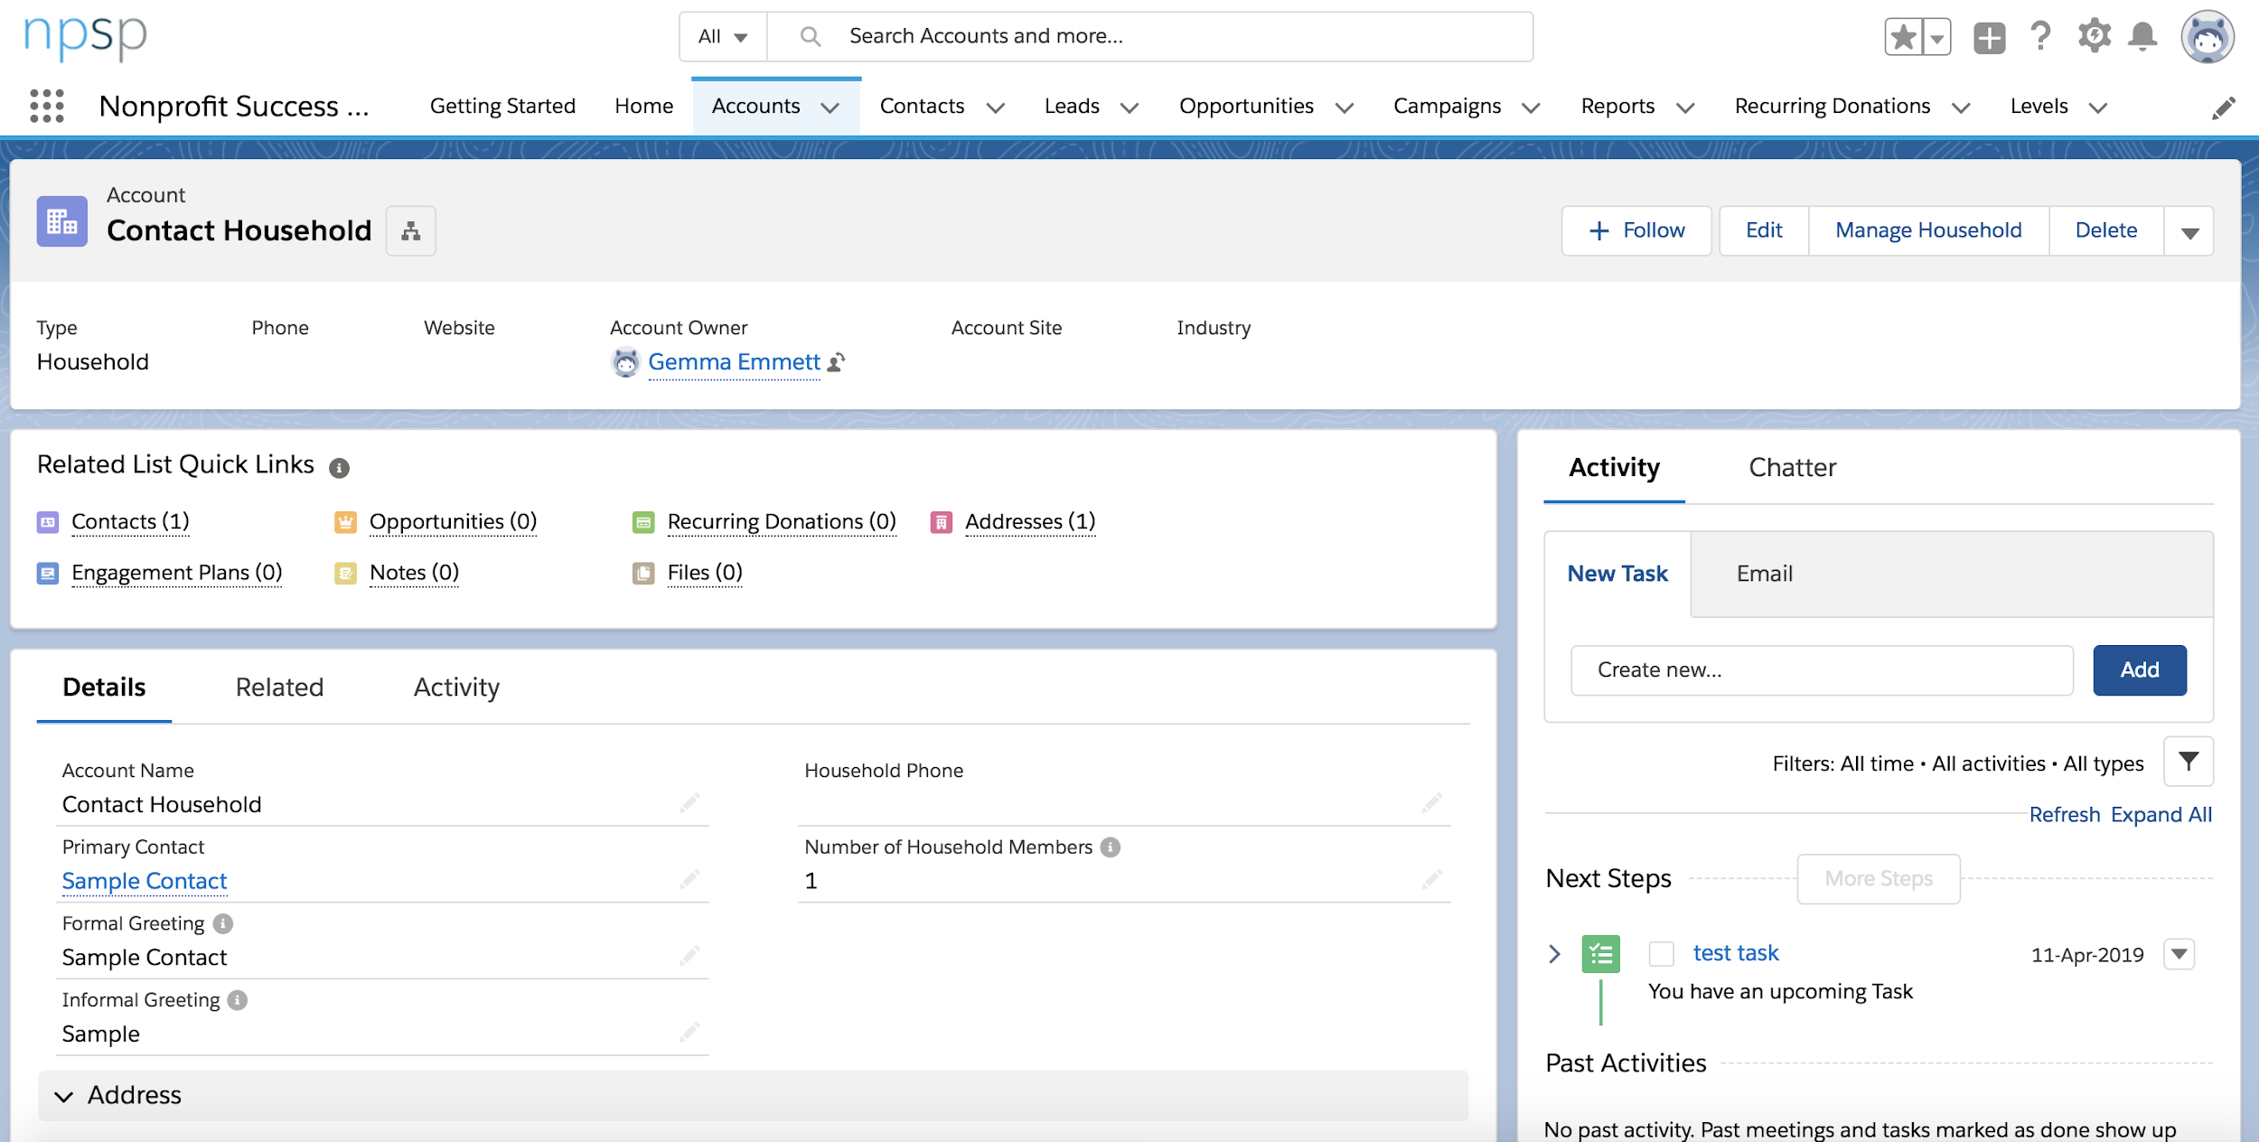
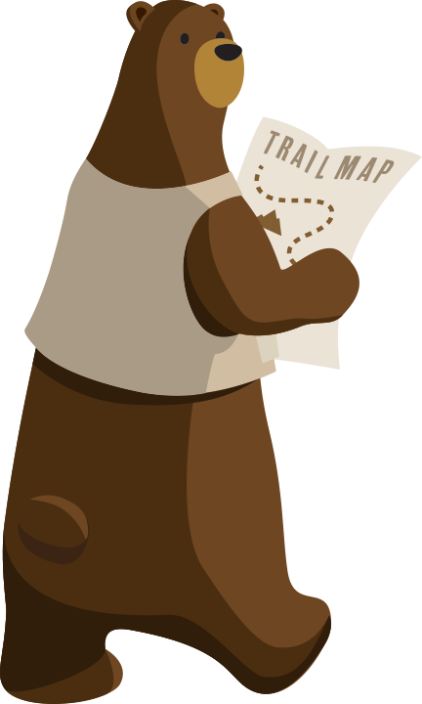
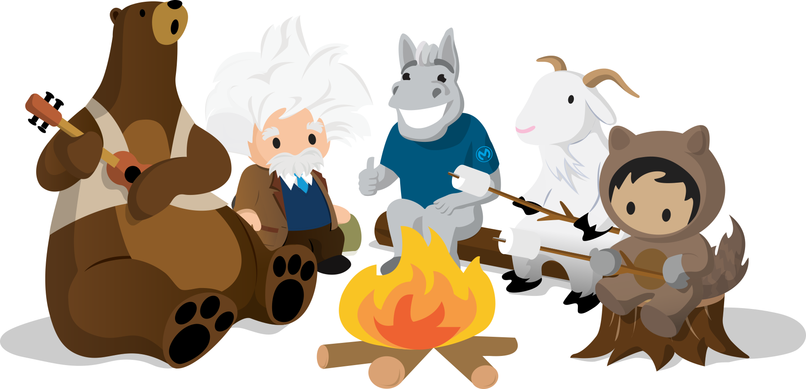
Identity & Access
Integration
Sharing & Visibility
Mobile
Custom Code
Community
Application Design
Data
System Governance
Data Governance
Stakeholder Management
Notes:
Those of you in the room who have been doing this a while know that designing a system takes all these considerations
This will probably look quite familiar to admins in the room
Talk about Camfed

Slide 5
Trailhead
Projects
Certifications
Notes:
Gaining the knowledge and experience you need to be a successful architect takes a combination of different things
I started without TH. My focus was web research and bitter experience
If I could do it all again I'd like to be smarter about it

Slide 6
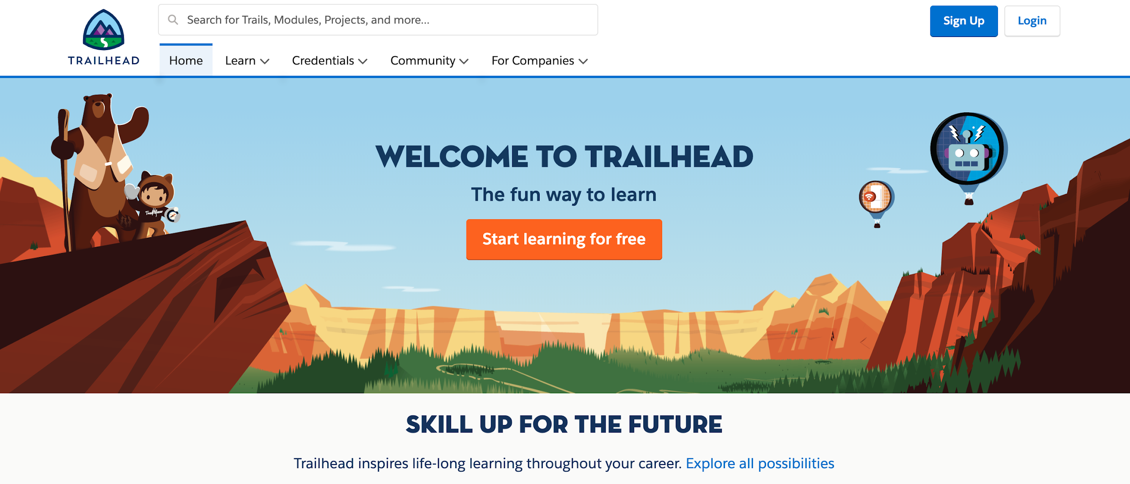
Be Smart with Trailhead
Get Superbadges
Don’t play Pokemon - read, watch, learn, use
Notes:
Use Trailhead to help you stay current. As humans, we have a competitive nature, but you can make the best of this platform by focusing on cementing your knowledge through exercises – then applying them. Use badges to learn and superbadges to apply.
If you’re an employer and you’re hiring, why not ask at interview whether your candidate has any superbadges? They’re a great way to test how the candidate intends to focus their learning – are they collecting badges, or are they looking to use their knowledge?

Slide 7
Be Smart with Your Career
Make Your Job Work for You
END USER
CONSULTING
ISV

Slide 8
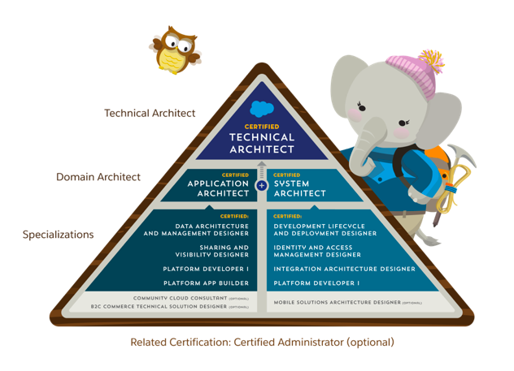
Be Smart with your Certifications
Align them to your work experience

Slide 9
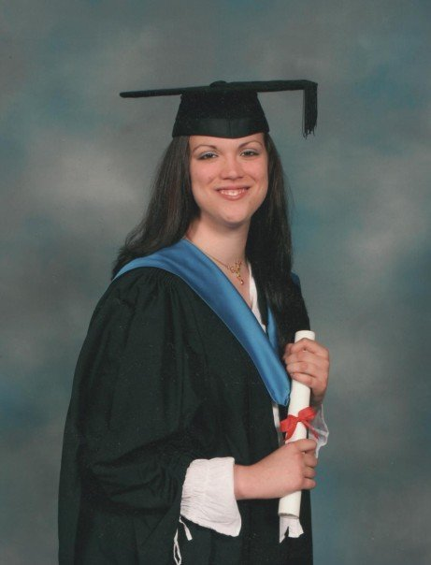
Gemma’s Career Story
2019
First CTA Attempt
2017
Architect
2018 #JourneytoCTA
ISV
2013
Enterprise Consultant
2010
Contractor
2009
Consultant
pre-2008
Spreadsheet fiend
Business Information Systems Degree
2008
Admin
Career
Notes:
Spreadsheet monkey - working in sales ops, had a technical background and education
Fell into a Sales Ops role with D&B; early adopters of Salesforce, supporting 250 sales people in the UK, plus admins abroad in Benelux, Japan, Italy and Canada
After 18m I wanted to help people implement it. Got a job with a boutique firm, then went contracting. Completed about 30 projects
Mollie came along in 2012
In 2013 I stopped contracting, worked at Capgemini for a while before switching to an ISV later that year.
2013 was a ridiculous year of change. A week before my wedding, I found a lump on my breast that turned out to be stage 3 cancer. By 2014 I had finished all my treatment: chemotherapy, minor surgery, radiotherapy and biological therapies and was ready to drop back into my career implementing PSA and ERP. It had all been taken care of.
That’s when I truly grew to become an architect. Tying multiple managed packages together to produce a complete business solution for a complex London-based consultancy, then doing the same for a UK government agency, made me realise what I enjoyed doing the most. I naturally grew to become more than a consultant; I was more focused on the bigger picture. I’d been doing it for years…since the beginning, in fact. The difference was that now there was a specific role for that.
I applied for an SA job at Bluewolf in 2017 and got it. It turned out to be the best environment for me to flourish. I went from 5 certs to sixteen, all because I worked for an organisation that empowered and enabled me. It didn’t need any justification.
My personal journey to CTA began early this year, with mock exams and a great mentor. I was all booked in for the May review board in London.

Slide 10
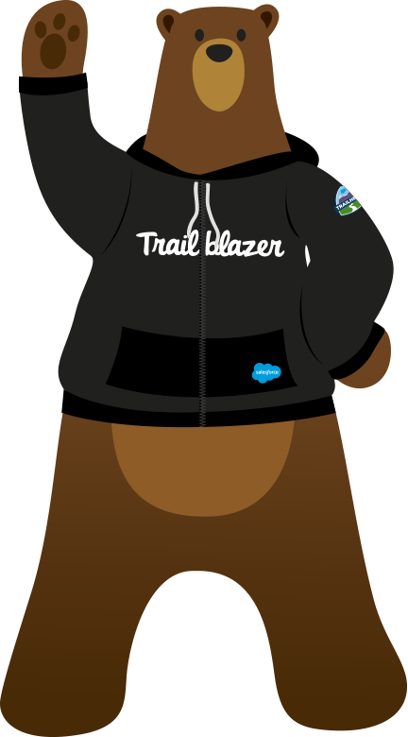
Things You Can Do
Study with a Friend
You’ve got different experiences
Slow Down
It’s a marathon, not a race
Bored? Try Something Different
If you’re not scared of your dreams, they’re probably not big enough!
Volunteer for Projects that Challenge You
Stay Current with Trailhead
Value Every Single Experience
Even the bad ones!

Slide 11
What will YOU do?
Fix Trees, adjust banner

